Slide 1
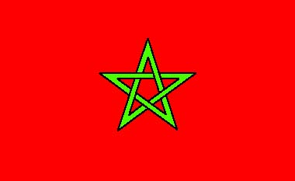
Morocco’s Flag

Slide 2
Morocco
Morocco is located in the north western Part of Africa and its capital city’s called Rabat .
the official language of Morocco is Arabic, although French has also status and used widely in business and high education.

Slide 3
Moroccan Darija « dialect » is the widely spoken tangue, and it’s quite different from the classical Arabic of Qur’an.
Many Moroccans understand Arabic Dialects in neibhoring countries.
Amazigh people form 50% of the Moroccan population, they speak Amazigh dialect in adittion to Arabic.

Slide 4
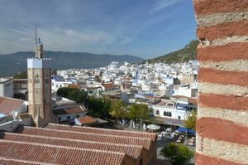
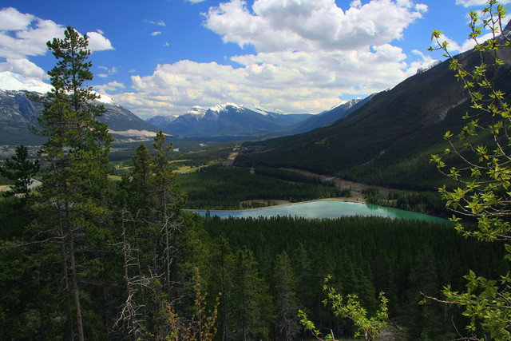
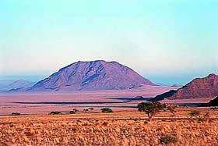
Morocco’s Land
Morocco has many different types of land. Deserts, towns, mountainsides. The farms there, are usually near rivers, lakes, ponds or streams.

Slide 5
Moroccans generally shake hands when greeting, and after which one might touch the heart, to express pleasure at seeing the other person.
It is impolite to point at people.

Slide 6
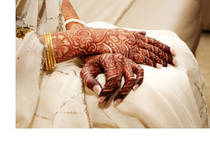
Weddings
Wedding signify a new union between two families, it’s usually last two days, the first day in the Bride’s house all families come together sing and dance, it s called Nhar Lhanna. They decorate the bride’s hands and feet with Al Hanna.

Slide 7
In the second day, the groom’s Family and the bride’s family celebrate the wedding togeter to show that they are one family.

Slide 8
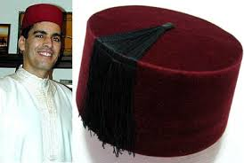
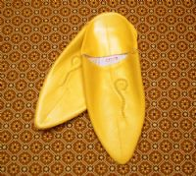
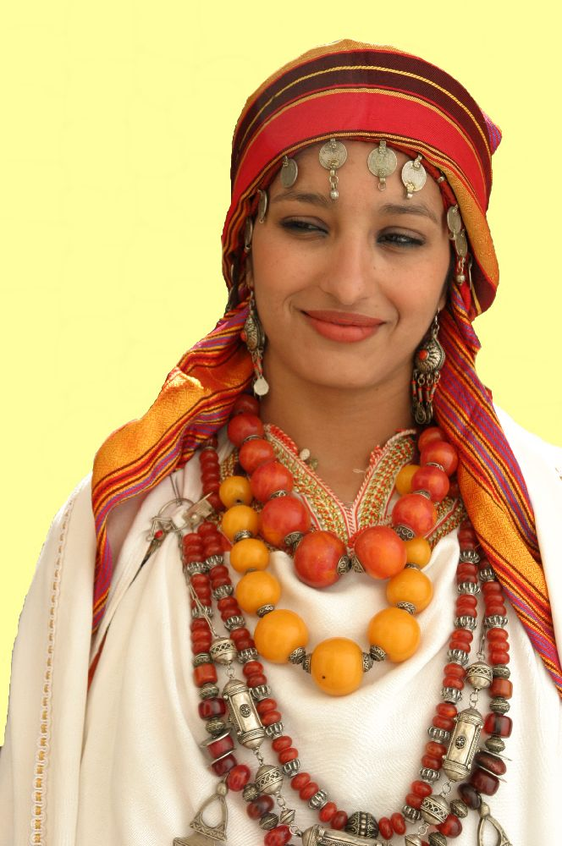
The traditional dress for men and women is called Djallaba
For special occasion men also wear a red cab called « Tarbouch al fasi » and mostely refered to Fez city, also the wear Balgha often yellow.
As for women they wear caftan.

Slide 9
Music
Andalusian music: as it s name indicates comes from Andalusia, it is a blend of Arabic and spanish music, and it is considered to be Morocco’s classical music which sung in classical Arabic ( Fosha)

Slide 10
the second type of music is Amazigh music, the three different Amazigh regions in Morocco possess their own dialect and their own Amazigh rhythm, this kind of music has survived thanks to Amazigh’s poets and musicians.

Slide 11
Shaabi is considered as pop music since it’ s indeed the most popular music listened to in Morocco, and it is sung in Darijja and usually in weddings.

Slide 12
FOOD
Morocco’ s food is well known through the world, it combines traditional Amazigh dishes with spices from Arab World and ingredients from spain.
Each Friday Moroccans eat couscous which is a dish made of cracked wheat.

Slide 13
Another popular dish in Morocco is Tagin, a stew of spiced vegetables and meat or chicken.

Slide 14
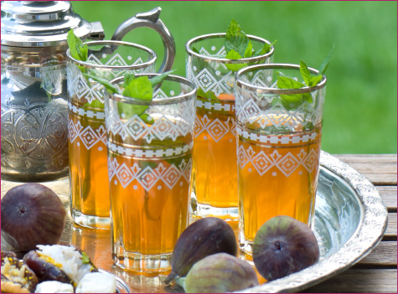
One of the most tasty Moroccan dishes is Pastilla, a delicate pastry stuffed with chicken breast or meat re shrumps, cinnamon, suggar and crunched nuts.
Night and day Moroccans drink two popular drinks, freshly squeezed orange juice and mint tea, the national drink.

Slide 15
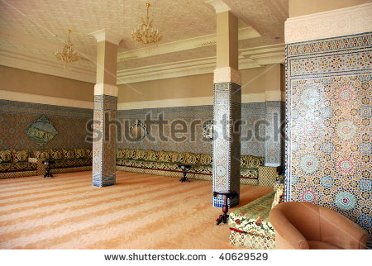
Notoriety
Morocco style is fascinating with its decorative arts and richness of beautiful colors and patterns,Morocco inspired the house interior due to its blend and fusion of african, andalusian, arabian, Amazigh, and european style that created a unique and timeless design

Slide 16
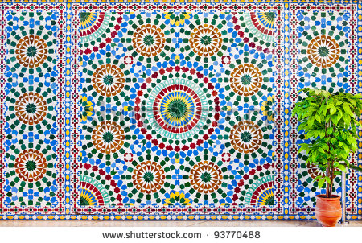
Zallij
One of the elements in Moroccan interior design and home decorating is Zallij.
Zallij is the art of hand cutting geometric mosaics.

Slide 17
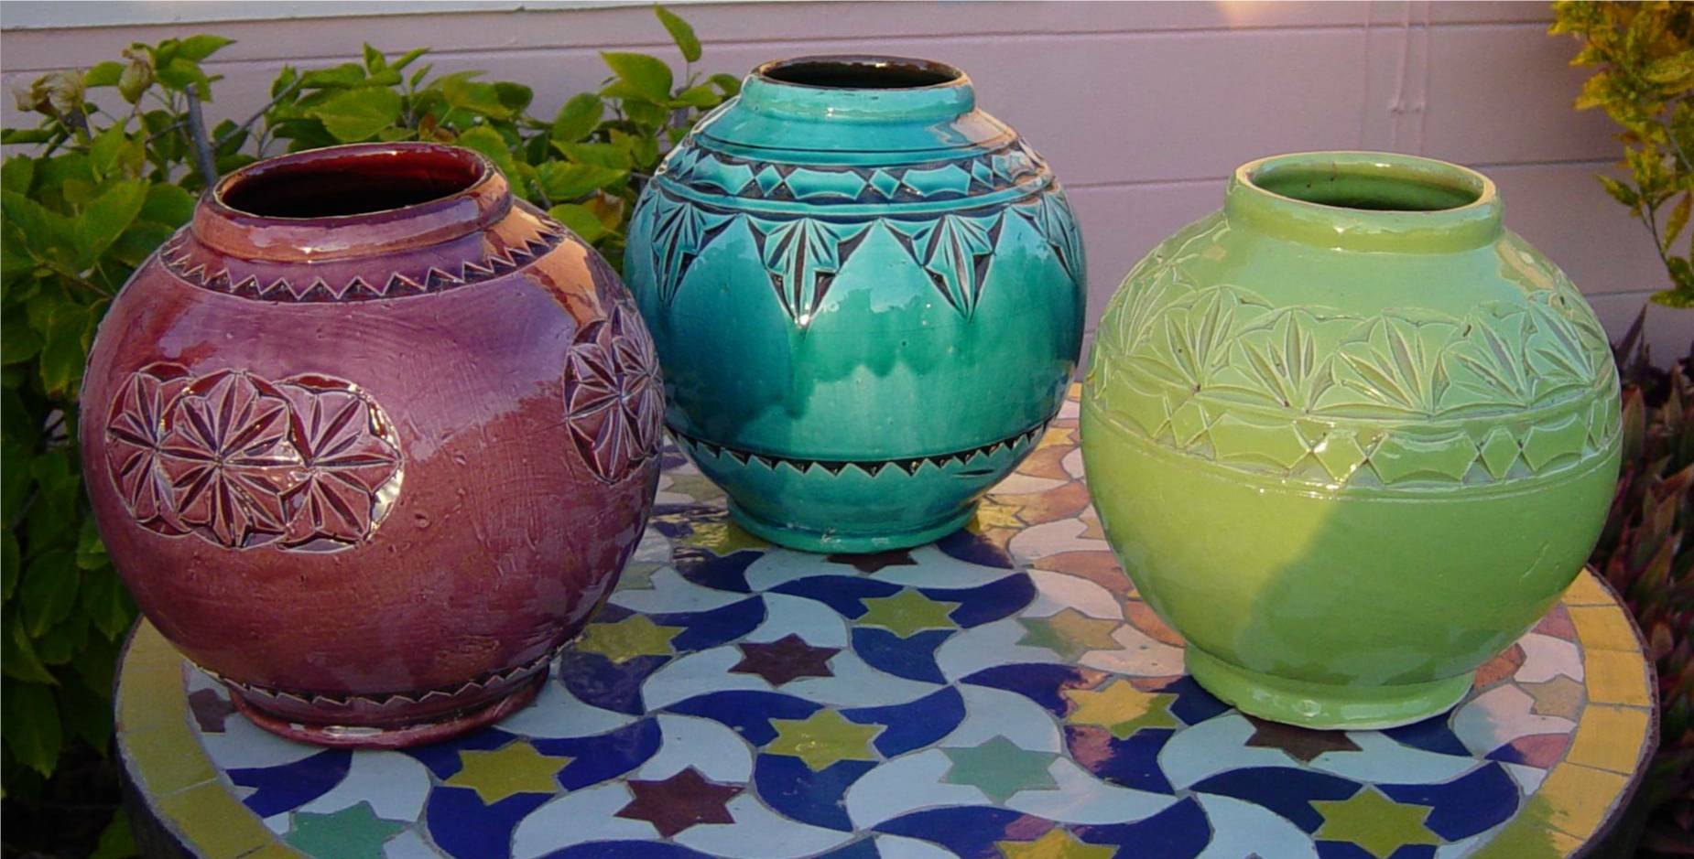
Pottery
Along with Zallij, Morocco is famous of traditional pottery. And it is for both practical and artistic purposes , and some of finest pottery is produced in the region of Zagura.

Slide 18
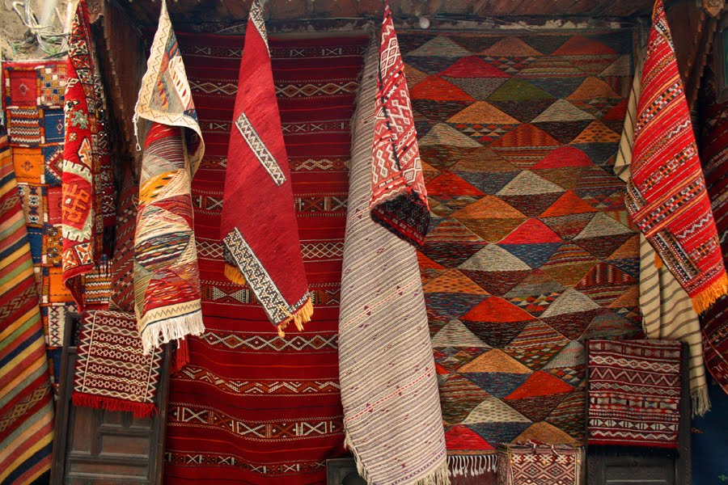
Carpets
Moroccan carpets are also famous around the world specially the Amazigh traditional carpets.

Slide 19
Thank you for your attention.

